Slide 1
Managing Products
After successfully installing Magento, you can now take on the task of creating and configuring your store.
You could begin by crafting the design that reflects your store's brand, or you could start configuring the many settings that will direct how your customers will interact with your online store.

Slide 2
Managing Products
The following topics are covered:
Creating categories
Managing products and attributes to help your customers shop more easily
Setting up reviews, tags, and feeds to help promote your products
Importing products

Slide 3
Catalogs and categories
The use of the terms catalogs and categories in Magento used to be a bit confusing, as Magento tended to use these terms with some inconsistency.
In Magento 2, the distinction is better defined.
In Magento, the catalog is the full collection of products within your Magento installation.
Looking under Products | Catalog in the backend, you can view all your products regardless of to which Website or categories they may be assigned.

Slide 4
Categories in Magento 2 are just that: categories of products.
Creating categories
For our furniture store, we want to create a new subcategory for sofas:
1. Go to Products | Categories in your Magento backend.
2. Click on Furniture in the list of categories on the left.
3. Click on Add Subcategory.
4. For Name, enter Sofas .
5. Set Is Active to Yes .
6. Click on Save Category.

Slide 5
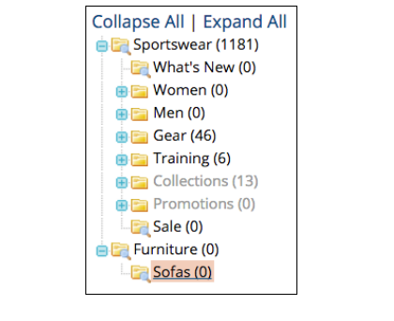

Slide 6
General information tab
there are only two required fields when creating a category (Name and Is Active)
URL Key: Once you create a category, Magento will automatically create a unique URL Key. This becomes the path for your category, such as www.acmefurniture.com/sofas.html . The sofas part is the URL Key. If you create more than one category with the same name,
Magento will create unique keys by adding an incremental number, such as "sofas-1," "sofas-2."

Slide 7
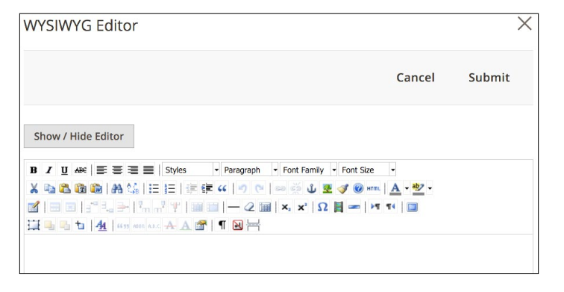
Description: In the front end of your store, the Description tab will appear at the top of the category page, giving you the ability to describe the category to shoppers, as well as adding more SEO rich content. The field has a very basic WYSIWYG editor.

Slide 8
The other attributes are Image, Page title, Meta Keywords, Meta description, Include in Navigation Menu.
Display Settings tab:
  Display Mode
  CMS blocks
  Is Anchor
  Available product listing sort by
  Default product listing sort by
  Layered Navigation Price Setup

Slide 9
Custom Design tab
  In this tab, you can control specific display configurations for your category
  Use Parent Category settings:
  Apply to Products
  Custom Theme
  Active From/Active to
  Page Layout
  Custom Layout Update

Slide 10
Category Products tab
  When you create products in your Magento Store, you can assign the product to a category. Alternatively, you can assign multiple products to a category within this tab.
  Selection Column
  Search fields
  Save Category

Slide 11
Reordering Categories
  One can re-arrange the order of categories – they will appear in navigation menus- by dragging and dropping your categories in the sidebar display.

Slide 12
Special Categories
  Magento provides some inherent tools for grouping products for special display purposes. For example by designating New From and New To dates in the Advanced Settings | Autosetting panel of a product detail screen Magento will display a new products block, if today's date falls within range of these dates.

Slide 13
Products
Products are the items or things that are sold in Magento. Product can be anything that is capable of satisfying the customer’s needs. This includes both physical products and services.
Product Types: Magento provides 6 different types of products. Appropriate selection of product type is essential for accessing the appropriate set of features required to sell the product. Following are the product types available in Magento.

Slide 14
Products
• Simple Products
• Grouped Products
• Configurable Products
• Virtual Products
• Bundled Products
• Downloadable Products

Slide 15
Simple Products
These are general product type, which are the most used products. In this section, there are no options for selecting size or color of the product. Example: Coffee cup, DVD's, Camera lens, etc.
Grouped Products
This is a group of simple products. In this type, you cannot specify a specific price for a product; you can just specify the discount. Example: Cell phone + Memory card + Earphone
Configurable Products
In this type, customers can select products according to their color and size before purchasing.Example: Cell phones obtained in different colors and sizes.

Slide 16
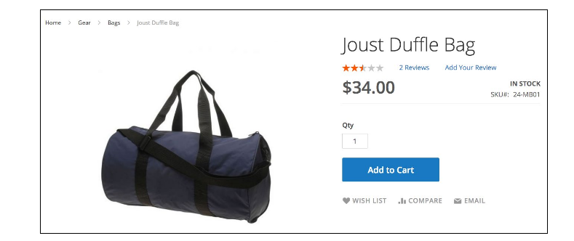
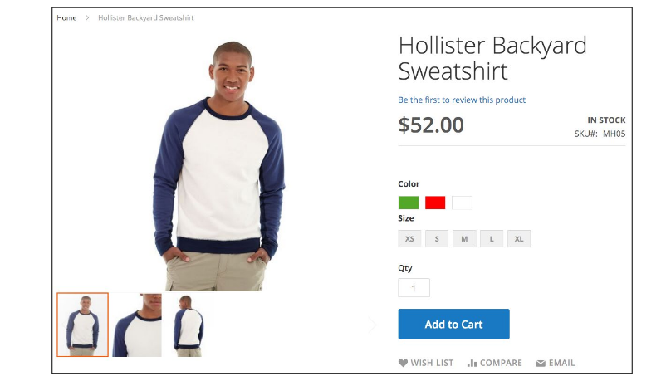
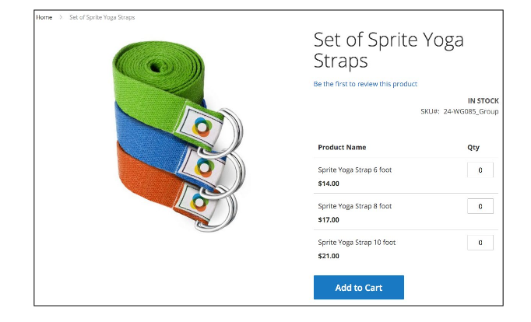

Slide 17
Virtual Products
Virtual products are those which do not have physical counterpart, i.e. these are used for virtual items. These products cannot be shipped or stocked. Example: Online training course.
Bundled Products
Bundled products are those products, which cannot be sold separately and doesn't give any choice to the end user. Example: Consider you want to buy a cell phone which includes earphone, memory card, battery, charging cable, etc. These are together called bundled products. These products cannot be sold individually but can be sold within the bundle product.

Slide 18
Downloadable Products:
Products which are available for download are known as downloadable products. Example: MP3 file, ebook, documents, etc.

Slide 19
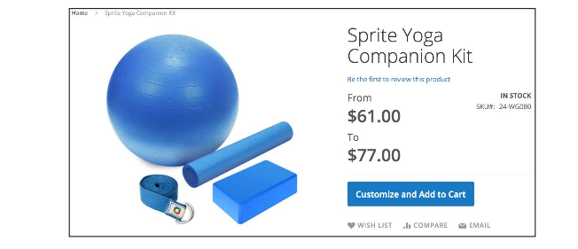
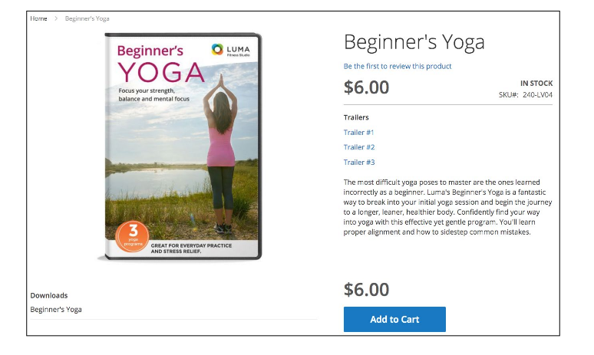

Slide 20
Product Attributes
Attribute describes the property of the product. Product attributes helps to set product properties such as color, size width, height, etc. and makes the product unique. You can add as many attributes to your product as required.

Slide 21
Product Attributes
Attribute Types
Different types of attributes are as follows:
  Text Field, Text Area, Date, Yes/No, Multiple Select, Dropdown, Price, Media image, Fixed Product Tax, Visual Swatch, Text Swatch

Slide 22
Related products, up-sells, and cross-sells
For each product you create in Magento, you have the opportunity to attract additional purchases from customers by linking products together. These crosslinks allow you to encourage shoppers to consider buying more products than the one they're reviewing.
Magento allows you, the store administrator, to encourage shoppers to spend more during their online visit using related products, up-sells,and cross-sells. All three types are managed within the Product Detail screen.
Each of the following product selling features are configured in the Product Detail screen under the Advanced Settings section. Each one has particular features and purposes.

Slide 23
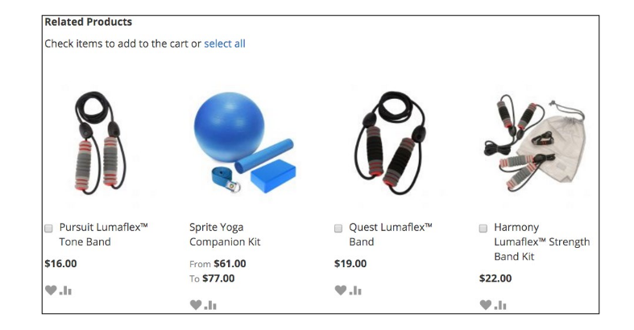

Slide 24
Upsell products
By contrast, upsell products are those to be considered as alternatives to the product the customer is viewing. That is, if the customer is interested in product A, they might instead consider product B. Not as an additional purchase, but instead of purchasing product A.
An upsell is to get the customer to spend more money – buy a more expensive model of the same type of product, or add features / warranties that relate to the product in question.

Slide 25
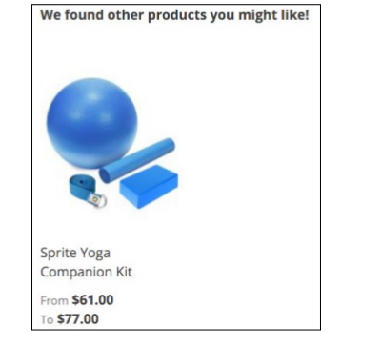

Slide 26
Cross-sell products
Cross-sell products are presented to your customer on the shopping cart page. For instance, if you want to encourage the purchase of an extended warranty, you could add it as a cross-sell product and it would be presented on the shopping cart. Your customer can add it to their order directly from the shopping cart.
A cross-sell is to get the customer to spend more money buy adding more products from other categories than the product being viewed or purchased.

Slide 27
Importing products
Creating products one-by-one is fine if you're only selling a few products, but many people choose Magento as a platform to sell hundreds and thousands of different products. Entering each product individually can take a long time, especially if you're writing unique product descriptions, uploading photos, and adding crosslinked products.

Slide 28
Importing products
The shortcut to importing products
Magento imports CSV files according to a specific layout scheme. Trying to configure an import file to accurately import a variety of different products, product types, attribute sets, and so on, will lead to many, many failed attempts as you try different ways of configuring the CSV to meet your needs.

Slide 29
1.Enter at least one product into your store representing the different types (simple, complex, bundle, and so on) that you will be using.
2. Fully enter the data for each product, including all options. You don't have to upload images, however.
3. Go to System | Import/Export | Export in your backend.
4. Export a product CSV file to your computer using your browser (in previous Magento versions, this export would be placed on your server and you would have had to FTP to your server to retrieve it).
5. Open the downloaded CSV file in Excel or Numbers.

Slide 30
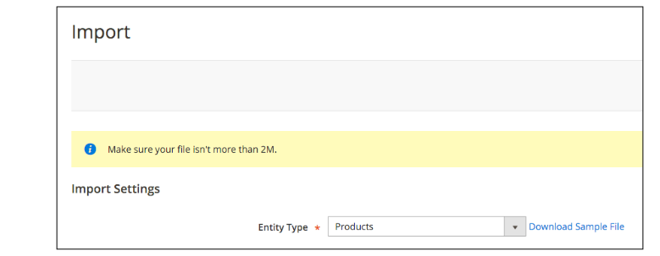
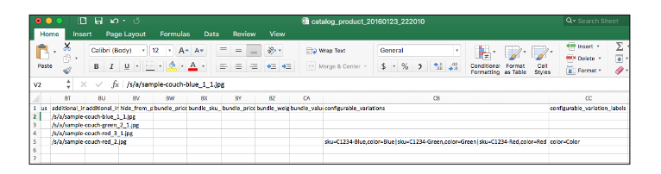

Slide 31
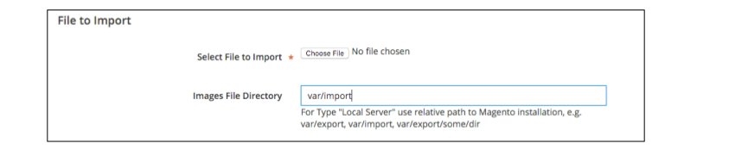
To import images, you must upload the images to your server in the /var/import folder. If the /var/import folder doesn't exist, you can create it (or another of your directory) and specify it as part of the import process.

Slide 32
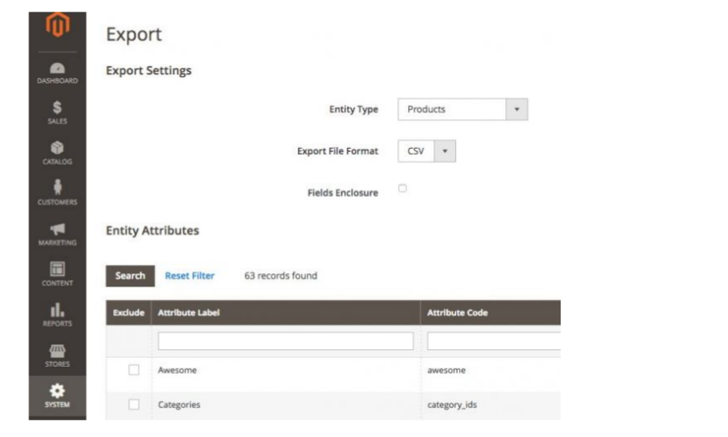
Exporting the products
In the Magento administrator area go to System menu > Data transfer section > Export. This would redirect you to a new page where you should select Products from Entity Type Dropdown and CSV from Export File Format.

Slide 33
Now you should exclude the unnecessary attributes from the list by selecting them and then click on Continue from the bottom of the page.
This will save a new file on your computer with a name similar to catalog_product_YYYYMMDD_randomnumber.csv .The file will include columns for each of the attributes you have defined for your products.

Slide 34
Open it in a spreadsheet program (MS Excel, Open Office Spreadsheet) and add the products you would like to import. Make sure you are copy/pasting the corresponding attributes in the correct columns.
Also here is when you will have to add the category IDs. Use the IDs from the text file you saved earlier and put the corresponding category ID for the products you are adding.

Slide 35
Once you have accomplished the above go back to the Magento administrator area and go to System menu > Data transfer section > Import. Now select Products from the Entity Type dropdown.
After that select Products from Entity Dropdown, and Add/Update from Import Behaviour dropdown. Now upload the CSV file by clicking on the Browse button next to Select File to Import. If you have added images, you should also specify the path on the server where youuploaded them. Add the corresponding path to the Images File Directory section.

Slide 36
